Slide 1
Lead Scoring Case Study
BY (1)Dhanya Mohan (2) Deepali Pandit (3) Kaustubh Tanpe

Slide 2
Contents
Problem statement
Problem approach
EDA
Correlations
Model Evaluation
Observations
Conclusion

Slide 3
Problem Statement
X Education sells online courses to industry professionals.
X Education gets a lot of leads, its lead conversion rate is very poor. For example, if, say, they acquire 100 leads in a day, only about 30 of them are converted.
To make this process more efficient, the company wishes to identify the most potential leads, also known as ‘Hot Leads’.
If they successfully identify this set of leads, the lead conversion rate should go up as the sales team will now be focusing more on communicating with the potential leads rather than making calls to everyone.

Slide 4
Business Objective
X education wants to know most promising leads. For that they want to build a Model which identifies the hot leads. Deployment of the model for the future use

Slide 5
Problem approach
Importing the data and inspecting the data frame
Data preparation
EDA
Dummy variable creation
Test-Train split
Feature scaling
Correlations
Model Building (RFE RsquaredVIF and p values)
Model Evaluation
Making predictions on test set

Slide 6
Data Cleaning
Total Number of Rows =37, Total Number of Columns =9240.
Single value features like “Magazine”, “Receive More Updates About Our Courses”, “Update me on Supply”
Chain Content”, “Get updates on DM Content”, “I agree to pay the amount through cheque” etc. have been dropped.
Removing the “Prospect ID” and “Lead Number” which is not necessary for the analysis.
After checking for the value counts for some of the object type variables, we find some of the features which has no enough variance, which we have dropped, the features are: “Do Not Call”, “What matters most to you in choosing course”, “Search”, “Newspaper Article”, “X Education Forums”, “Newspaper”, “Digital Advertisement” etc.
υ Dropping the columns having more than 35% as missing value such as ‘How did you hear about X Education’ and ‘Lead Profile’

Slide 7
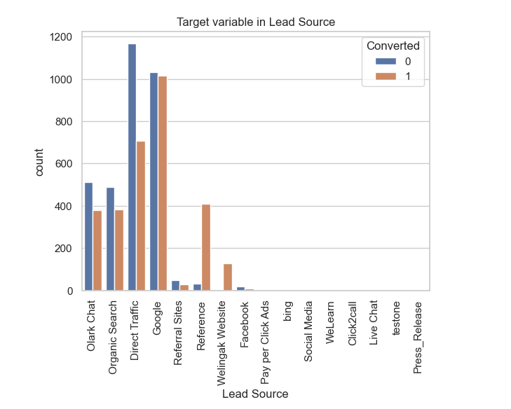
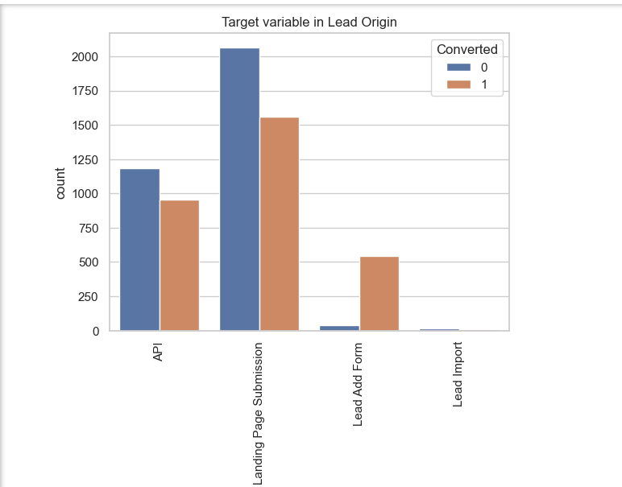
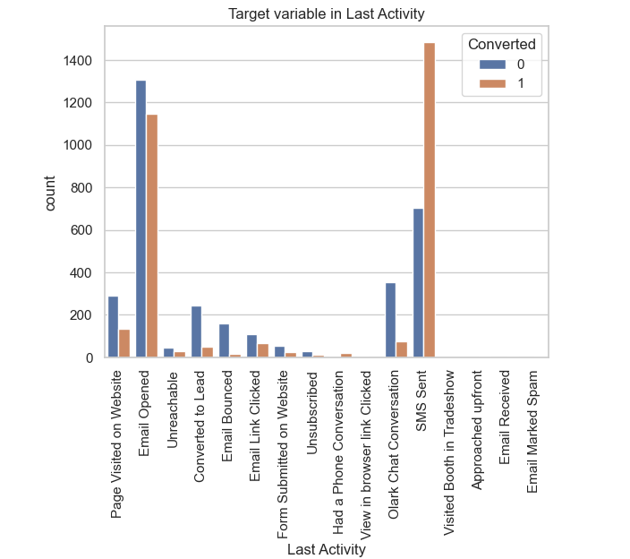
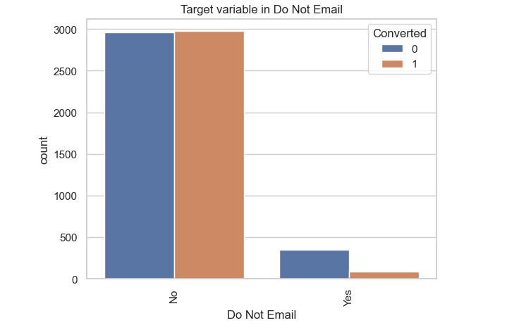
Categorical Variable Relation

Slide 8
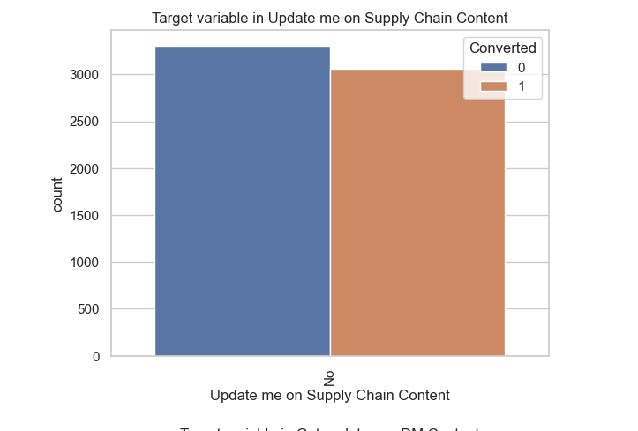
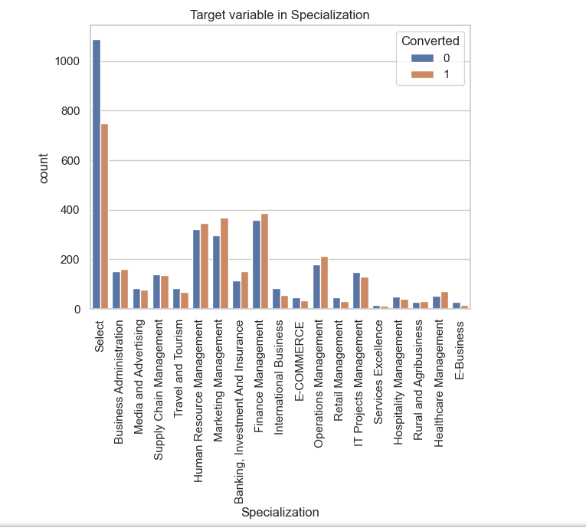
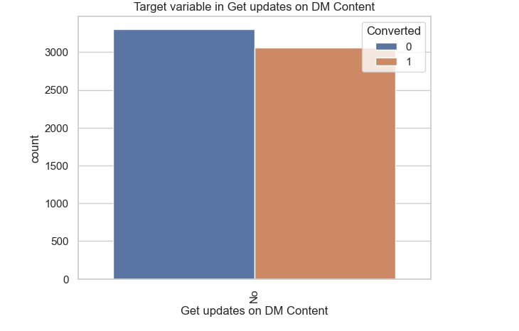
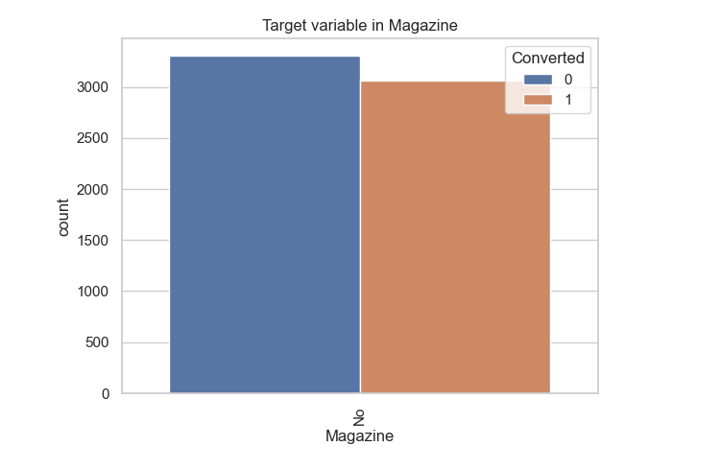
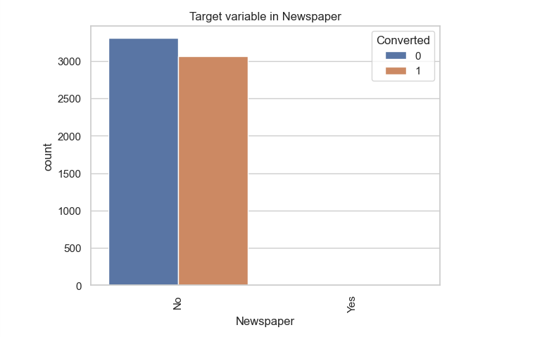

Slide 9
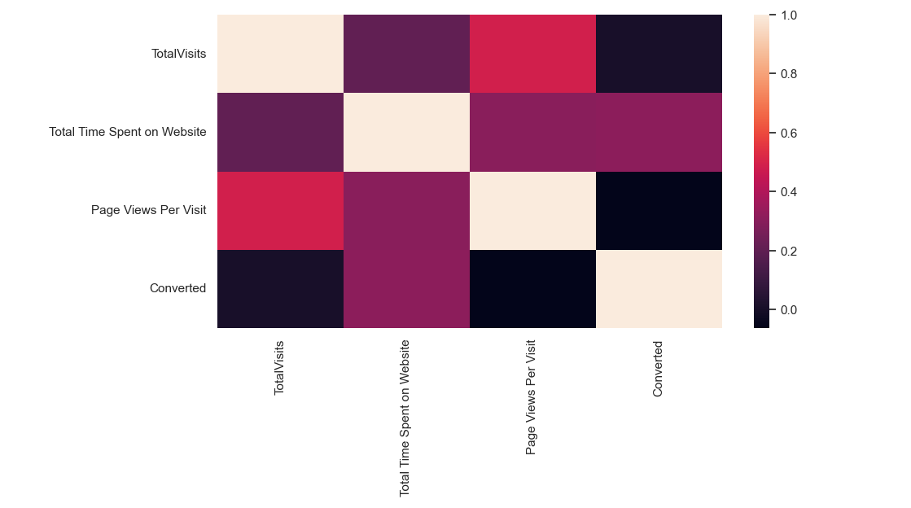
Correlation

Slide 10
Model building
Splitting the Data into Training and Testing Sets
The first basic step for regression is performing a train-test split, we have chosen 70:30 ratio.
use RFE for Feature Selection Running RFE with 15 variables as output
Building Model by removing the variable whose p- value is greater than 0.05 and vif value is greater than 5
Predictions on test data set
Overall accuracy 80%

Slide 11
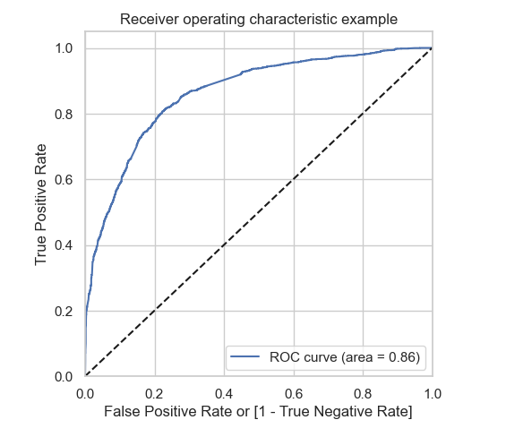
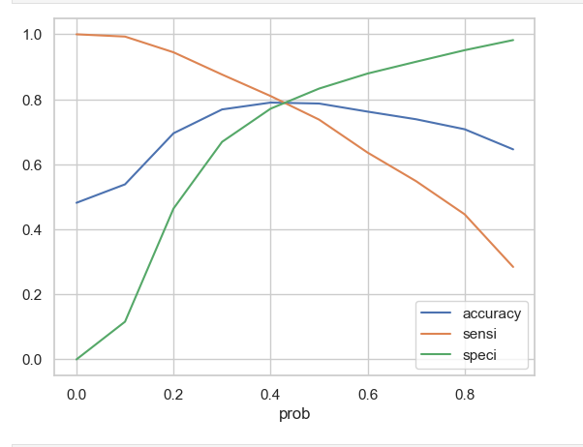
Roc curve

Slide 12
Conclusion
It was found that the variables that mattered the most in the potential buyers are (In descending order) :
The total time spend on the Website.
Total number of visits.
When the lead source was:
a. Google
b. Direct traffic
c. Organic search
d. Welingak website
When the last activity was:
a. SMS
b. Olark chat conversation
When the lead origin is Lead add format.
When their current occupation is as a working professional.
Keeping these in mind the X Education can flourish as they have a very high chance to get almost all the potential buyers to change their mind and buy their courses

